Slide 1

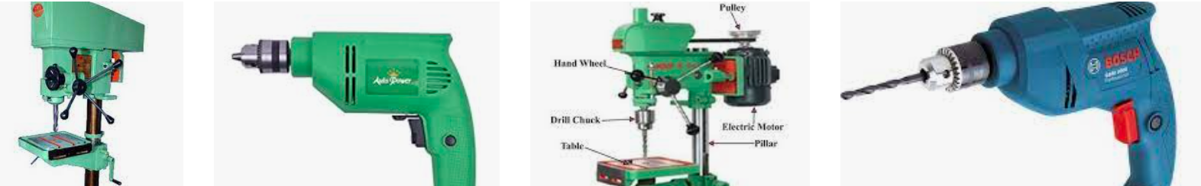
SAE-AM ----Year 2-S1
WORKSHOP PRACTICE II
Topic 1: Drilling Machine
Lecturer : Mr. Ernest NSHIMIYIMANA (MSc. Energy Eng.)
Email: erkey2020@gmail.com

Slide 2
workshop practice II
Part 1: Drilling operation
Part 2: Welding Processes
Part 3: Lathe machine

Slide 3
Part 1: Drilling operation

Slide 4
What is Drilling process ?
Drilling is the operation of producing circular hole in the work-piece by using a rotating cutter called Drill.
The machine used for drilling is called drilling machine.
The drilling operation can also be accomplished in lathe in which the drill is held in tailstock and the work is held by the chuck.
The most common drill used is the twist drill.

Slide 5
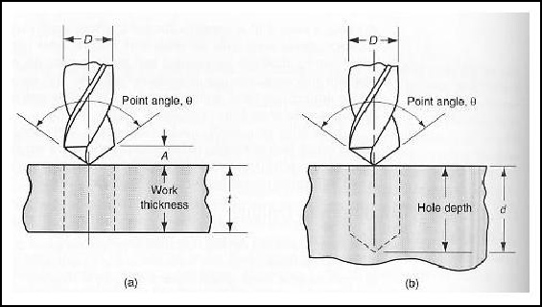
Types of holes
Drilled holes can be either through holes or blind holes. (see Figure below).
A through holes is made when a drill exits the opposite side of the work; in blind hole the drill does not exit on the other side of the workpiece.
Two types of holes: (a) through hole and (b) blind hole

Slide 6
Drilling Machine
It is the simplest and accurate machine used in production shop.
The work piece is held stationary ie. Clamped in position and the drill rotates to make a hole.
Two types :
Based on construction:
Portable, Sensitive, Radial, up-right, Gang,
Multi-spindle
Based on Feed:
Hand and Power driven

Slide 7
Types of Drilling Machine
The sensitive or bench drill is used for light drilling on small parts.
The upright drill press is used for heavy duty drilling and finally the radial drill press is used for drilling large, heavy work piece that are difficult to move.

Slide 8
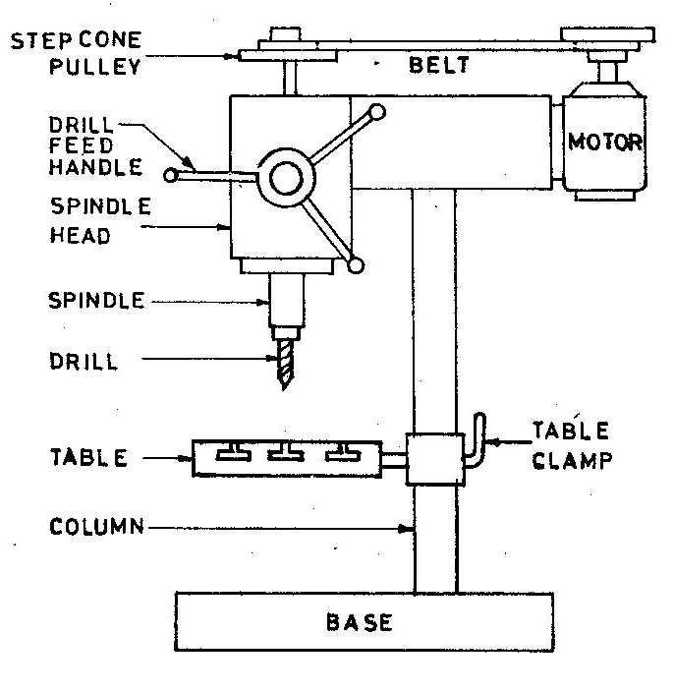
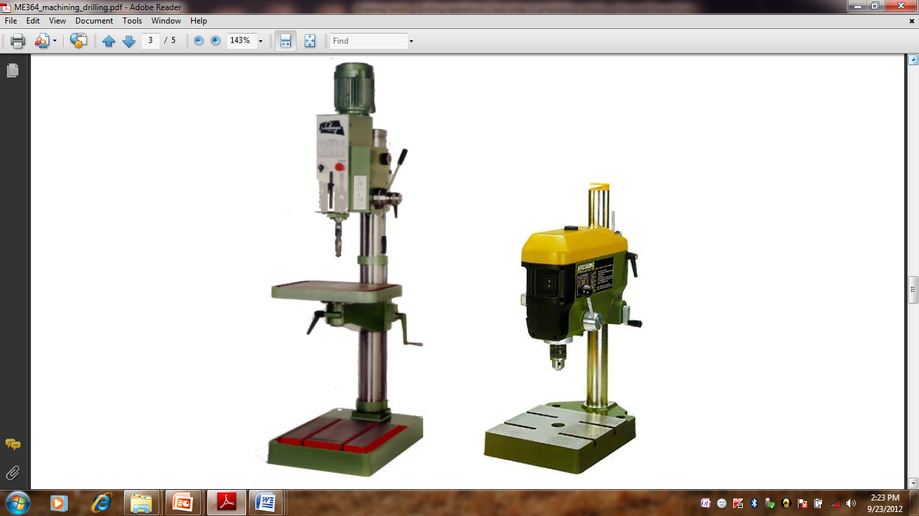
Types of Drilling Machine
Sensitive Drilling Machine
Drill holes from 1.5 to 15mm
Operator senses the cutting action so sensitive drilling machine.

Slide 9
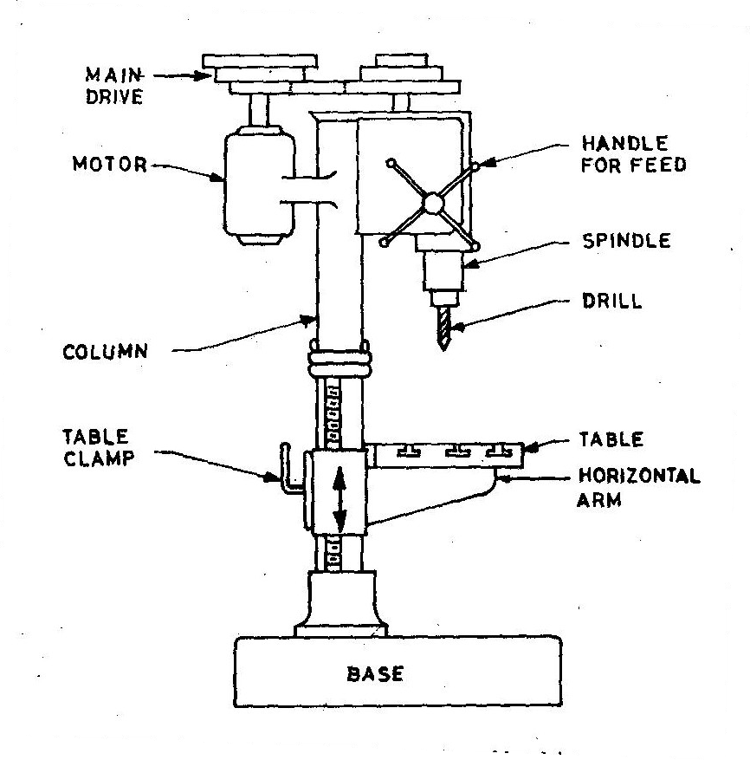
Types of Drilling Machine
Up-Right Drilling Machine
Drill holes up to 50mm
Table can move vertically and radially

Slide 10
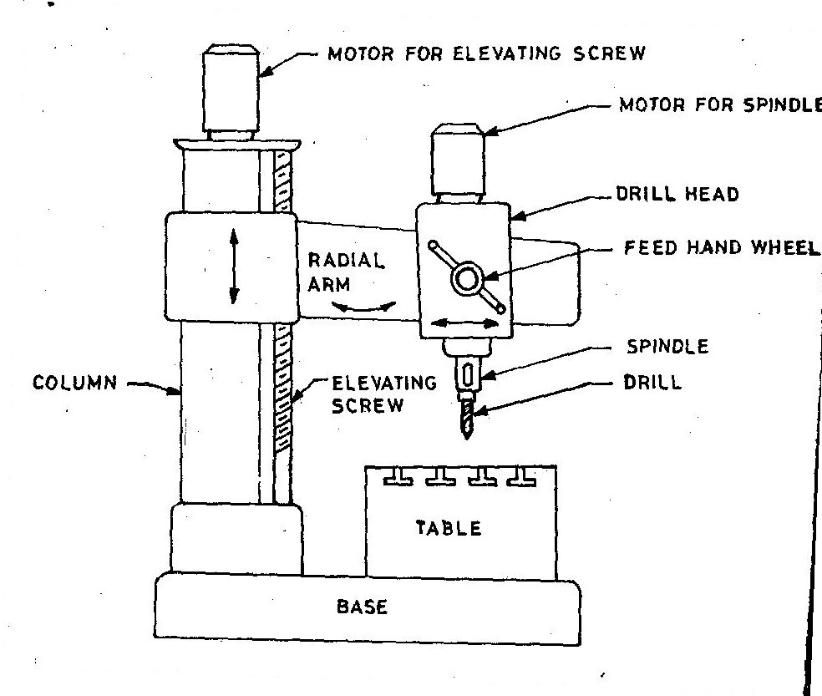
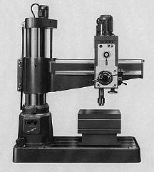
Types of Drilling Machine
Radial Drilling Machine
It is the largest and most versatile used for drilling medium to large and heavy work pieces.
It is designed to drill up to 100-mm diameter holes in large workparts.
It has a radial arm along which the drilling head can be moved and clamped.

Slide 11
Types of Drilling Machine
Other drilling Machine
The gang drill is a drill press consisting of a series of drill presses connected in an in-line arrangement so that a series of drilling operations can be done in sequence.
In the multiple-spindle drill, several drill spindles are connected to drill multiple holes simultaneously into the workpiece.
Numerical control drill presses (CNC)are available to control the positioning of the holes in the workparts.

Slide 12
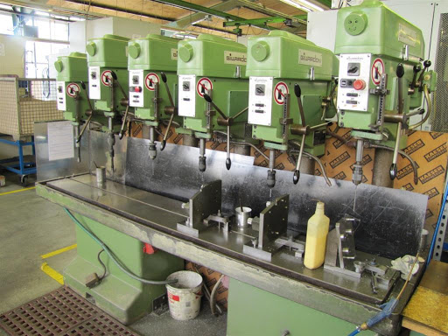
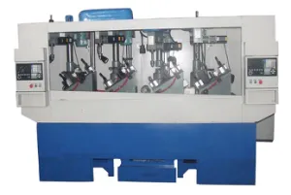
Types of Drilling Machine
Other drilling Machine- gang drill

Slide 13
Drill Materials
The two most common types are
  HSS drill - Low cost
    Carbide - tipped drills - high production and in CNC machines
Other types are
  Solid Carbide drill, TiN coated drills, carbide coated masonry drills, parabolic drills, split point drill

Slide 14
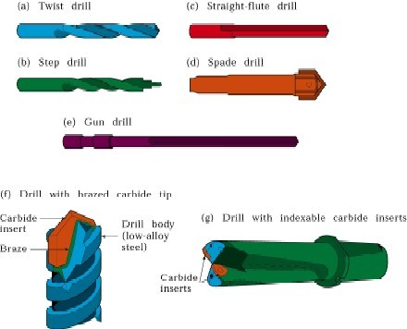
Drilling And Drills
Types of drills
Twist drill: most common drill
Step drill: produces holes of two or more different diameters
Core drill: used to make an existing hole bigger.

Slide 15
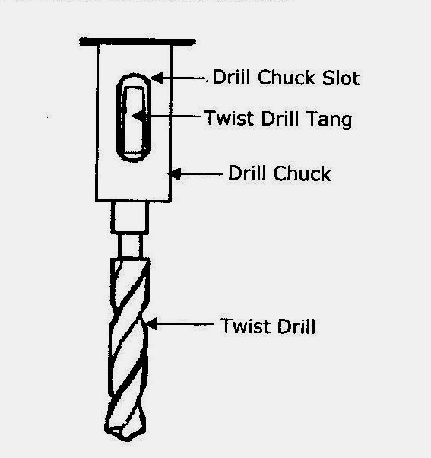
Drill fixed to the spindle

Slide 16
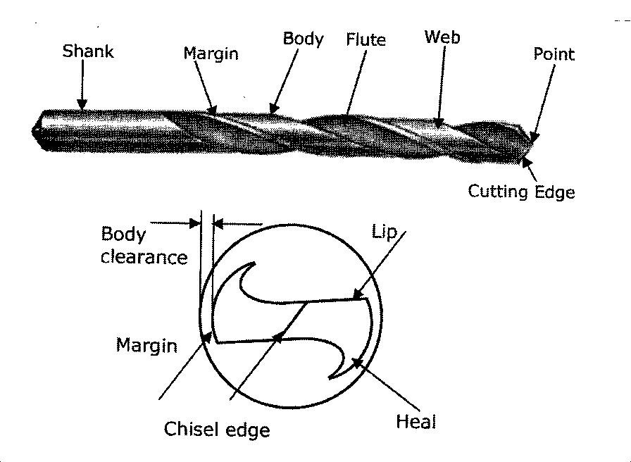
Tool Nomenclature

Slide 17
Tool Nomenclature
The different methods used for holding drill in a drill spindle are
By directly fitting in the spindle hole.
By using drill sleeve
By using drill socket
By using drill chuck

Slide 18
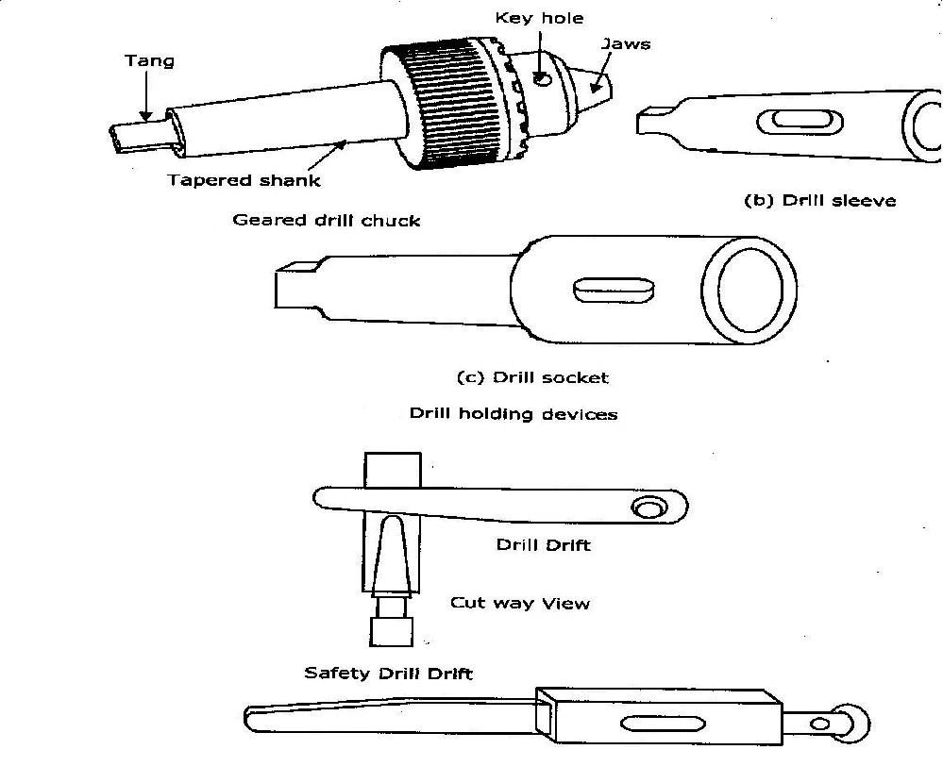
Work Holding Devices

Slide 19
Drilling operations…
Operations that can be performed in a drilling machine are:
Drilling,
Reaming,
Boring,
Counter boring,
Countersinking, and
Tapping

Slide 20
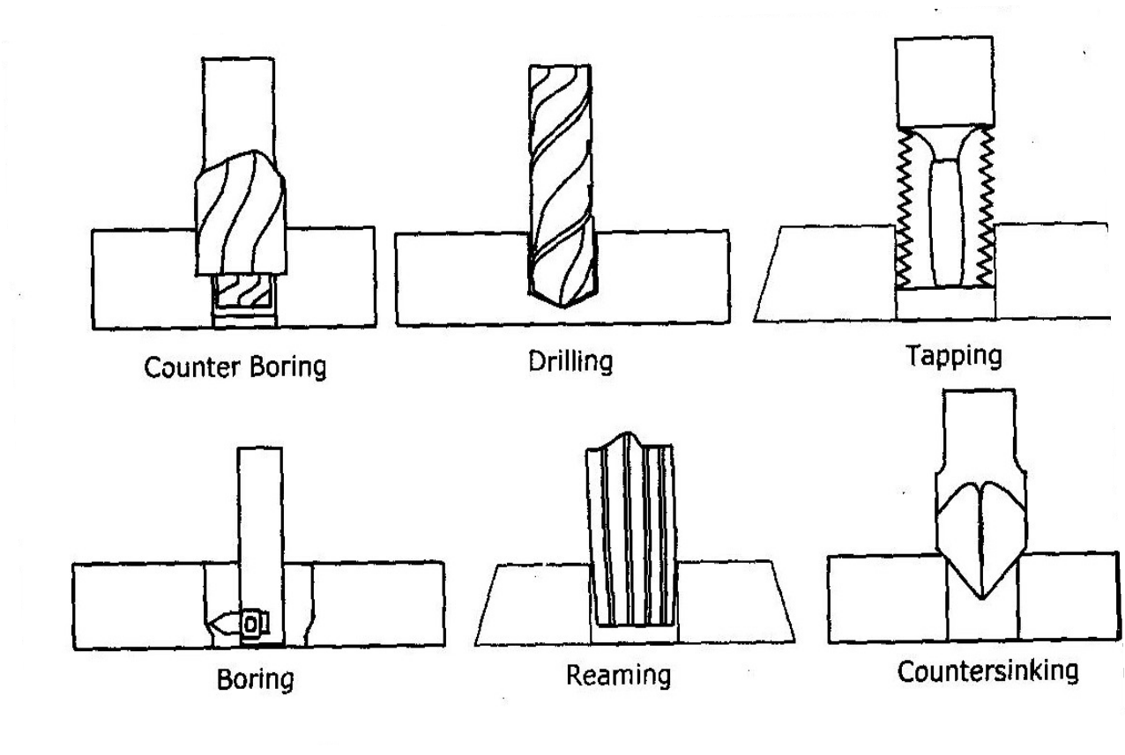
Operations in drilling machine

Slide 21
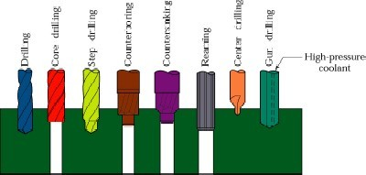
Operations in drilling machine

Slide 22
Types of cutters
Reamers :-
Multi tooth cutting tool
Accurate way of sizing and finishing the pre- existing hole.
Accuracy of +0.005mm can be achieved
Boring Tool:-
Single point cutting tool.
Boring tool is held in the boring bar which has the shank.
Accuracy of +0.005mm can be achieved.

Slide 23
Types of cutters
Countersinks :-
Special angled cone shaped enlargement at the end of the hole
Cutting edges at the end of conical surface. Cone angles of 60°, 82°, 90°, 100°, 110°, 120°
Counter Bore Tool:-
Single Special cutters uses a pilot to guide the cutting action .
Accommodates the heads of bolts.

Slide 24
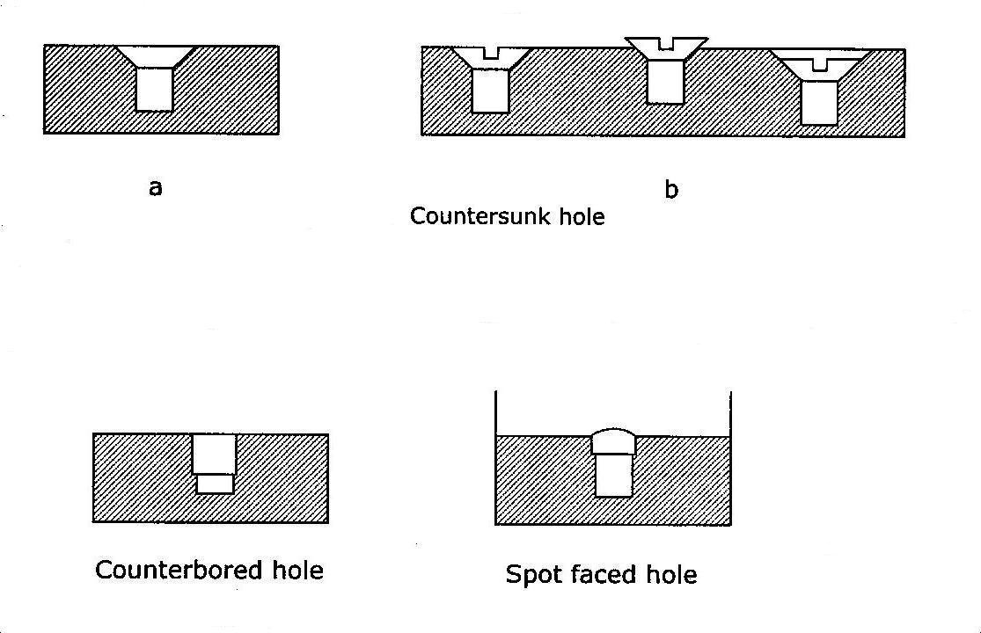
Types of cutters
Counter bore and spot facing :-

Slide 25
Types of cutters
Combined Countersinks and central drill:-
Special drilling tool to start the hole accurately.
At the end it makes countersinks in the work piece.
Gun drill :-
Machining of lengthy holes with less feed rates.
To overcome the heating and short life of the normal drill tool.

Slide 26
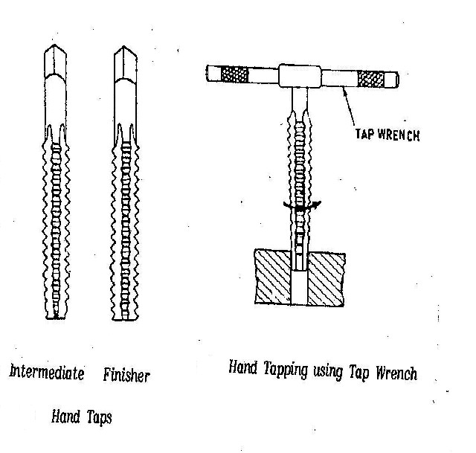
Types of cutters
Tapping:-
For cutting internal thread Multi cutting edge tool.
Tapping is performed either by hand or by machine.
Minor dia of the thread is drilled and then tapping is done.

Slide 27
Work Holding Devices
Machine Table Vice
Step Blocks
Clamps
V-Blocks
Angles
Jigs
T- Slots Bolt

Slide 28
drilling terminology
Cutting Speed (v):-
It’s the peripheral speed of the drill
V = Π*D*N where, D = dia of the drill in m
N = Speed of rotation in rpm
Feed Rate (f):-
It’s the movement of drill along the axis (rpm).
Depth of Cut (d):-
The distance from the machined surface to the drill axis.
d = D / 2

Slide 29
drilling terminology
Material Removal Rate:-
It’s the volume of material removed by the drill per unit time
MRR = (Π D2 / 4) * f * N mm3 / min
Machining Time (T) :-
It depends upon the length (l) of the hole to be drilled , to the Speed (N) and feed (f) of the drill.
t = L / f N min

Slide 30
Precautions for Drilling machine
Lubrication is important to remove heat and friction.
Machines should be cleaned after use
Chips should be removed using brush.
T-slots, grooves, spindles sleeves, belts, pulley should be cleaned.
Machines should be lightly oiled to prevent from rusting

Slide 31
Safety Precautions
Do not support the work piece by hand – use work holding device.
Use brush to clean the chip
No adjustments while the machine is operating
Ensure for the cutting tools running straight before starting the operation.
Never place tools on the drilling table
Avoid loose clothing and protect the eyes.
Ease the feed if drill breaks inside the work piece.

Slide 32
WORKOUT EXAMPLES
Determine the cutting speed in machining a workpiece of 200 mm diameter rotating at a speed of 100 rpm. Also, calculate machining time if the workpiece length is 0.5 m and feed is 0.45mm/rev.
Calculate the machining time to drill four 8 mm dia holes and one 40 mm dia central hole in the flange shown in Fig. 20 mm dia hole is drilled first and then enlarged to 40 mm f hole. Take cutting speed 10 m/min, feed for 8 mm drill 0.1mm/rev, for 20 mm drill feed is 0.2 mm/rev. and for 40 mm f drill feed is 0.4 mm/rev.

Slide 33
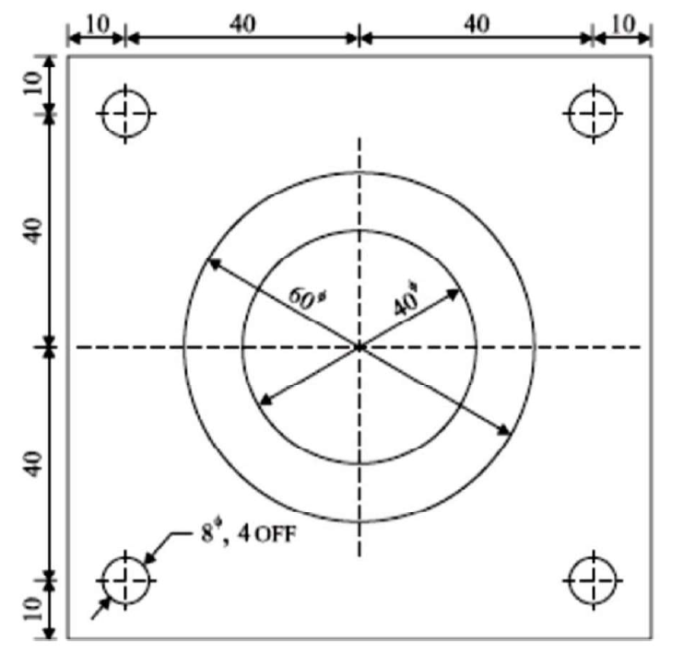
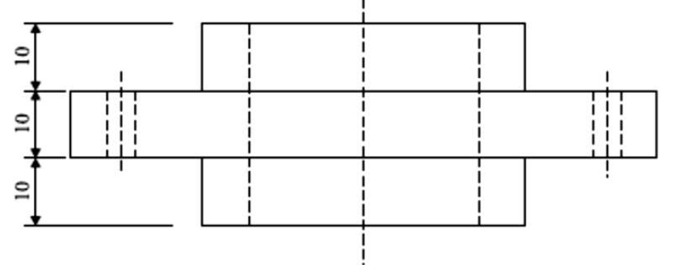
WORKOUT EXAMPLES
Calculate the machining time to drill four 8 mm dia holes and one 40 mm dia central hole in the flange shown in Fig. 20 mm dia hole is drilled first and then enlarged to 40 mm f hole. Take cutting speed 10 m/min, feed for 8 mm drill 0.1mm/rev, for 20 mm drill feed is 0.2 mm/rev. and for 40 mm f drill feed is 0.4 mm/rev.

Slide 34
Determine the cutting speed in machining a workpiece of 200 mm diameter rotating at a speed of 100 rpm. Also, calculate machining time if the workpiece length is 0.5 m and feed is 0.45mm/rev.

Slide 35

ANY Question?

Slide 36

Email: erkey2020@gmail.com/ e.nshimiyimana@ur.ac.rw

